Slide 1
Yaml code with variable
Install_apache2.yml
- name: Install apache server
hosts: all
become: yes
vars_files:
- vars1.yml
tasks:
- name: Install apache
apt:
name: "{{ package_name }}"
state: present
update_cache: yes
- name: Start apache
service:
name: "{{ package_name }}"
state: started
enabled: yes
var.yml
package_name: apache2

Slide 2
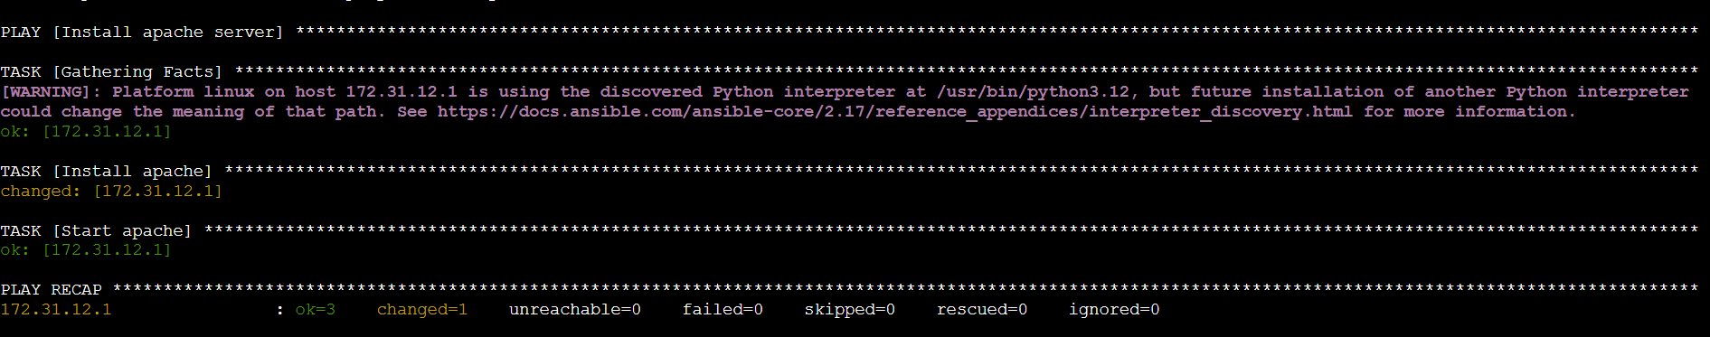

Slide 3
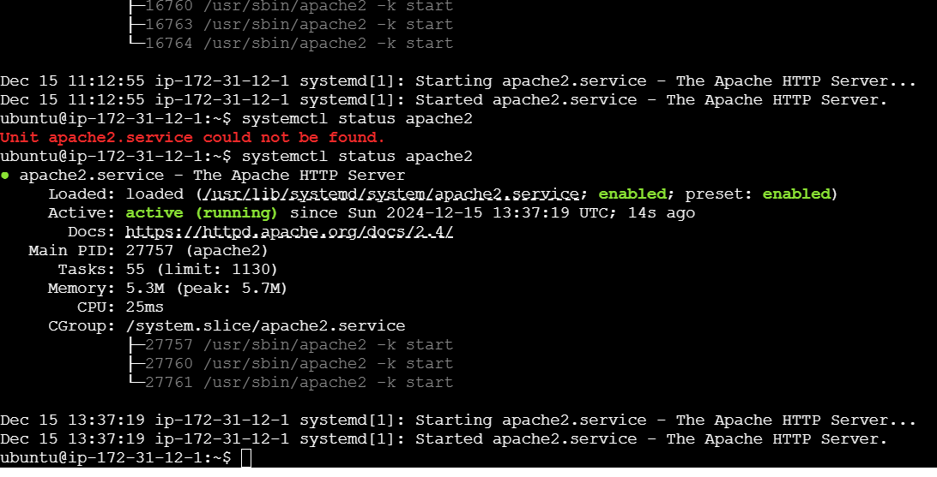
Output in slave machine – apache2 is installed

